Slide 1
Amazon Cognito
Lecturer: Ngo Huy Bien
Software Engineering Department
Faculty of Information Technology
University of Science
Ho Chi Minh City, Vietnam
nhbien@fit.hcmus.edu.vn

Slide 2

Objectives

Slide 3

Contents

Slide 4

References

Slide 5
Amazon Cognito
https://aws.amazon.com/cognito/
Amazon Cognito processes more than 100 billion authentications per month.
The service helps you implement customer identity and access management (CIAM) into your web and mobile applications.
You can quickly add user authentication and access control to your applications in minutes.

Slide 6
Why Amazon Cognito?
With Amazon Cognito, you can add user sign-up and sign-in features and control access to your web and mobile applications.
Amazon Cognito provides an identity store that scales to millions of users, supports social and enterprise identity federation, and offers advanced security features to protect your consumers and business.Built on open identity standards, Amazon Cognito supports various compliance regulations and integrates with frontend and backend development resources.

Slide 7


Slide 8
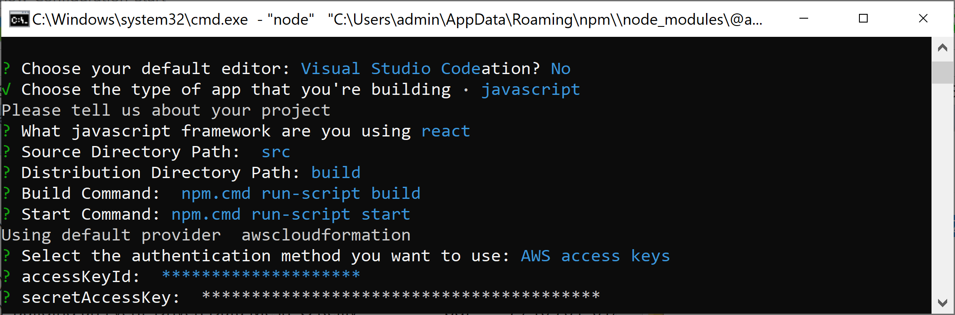
1. Set Up Amplify Project Info

Slide 9
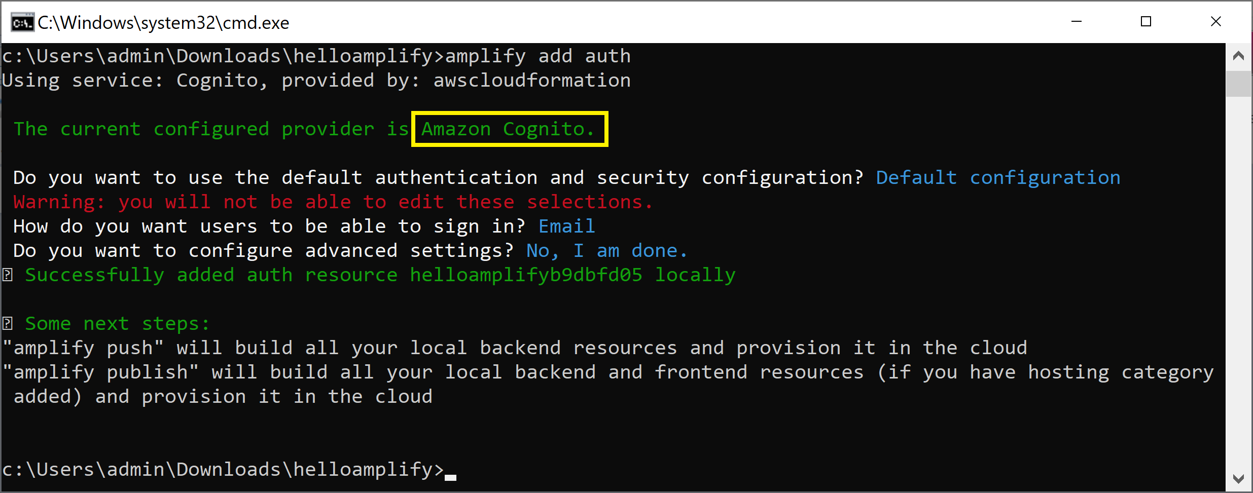
2. Add Cognito to Backend
amplify add auth

Slide 10
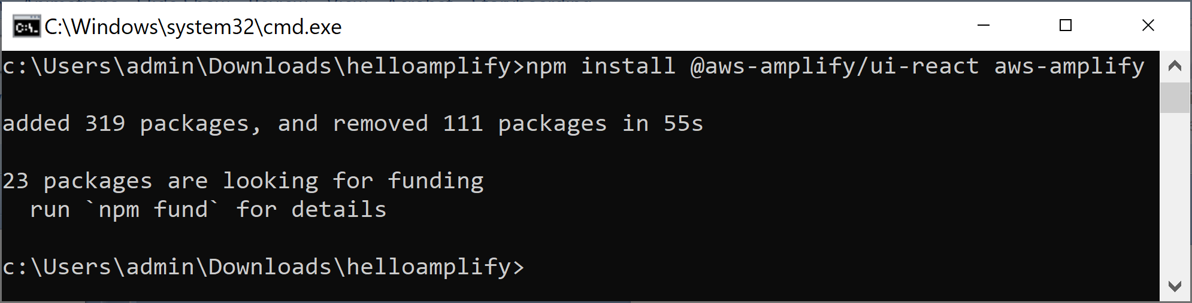
3. Install Dependencies
npm install @aws-amplify/ui-react aws-amplify

Slide 11
4. Add the Authenticator
npm install @aws-amplify/ui-react aws-amplify

Slide 12

Thank You & See You Again

